Slide 1

SALARY PREDICTION
An Intelligent Web Application for Predicting Salaries in Tech Roles

Slide 2

Abstract
This project creates a web app that predicts salaries for tech jobs using machine learning. Users can enter details like job title, location, and skills, and the app will estimate the salary for that job. It also includes features like showing raw data, creating charts, and uploading files for predicting salaries in bulk. This tool helps job seekers and employers make better decisions about tech salaries.

Slide 3
Problem Statement
Job seekers and employers often face difficulties in predicting accurate salaries for tech roles due to the lack of personalized and real-time tools.
Current platforms offer static or generalized information that doesn't consider factors like skills, company type, or location.
This leads to unrealistic expectations and poor decision-making during job negotiations.
There is a need for a dynamic, machine learning-based application that provides customized, real-time salary predictions to support informed career and hiring decisions.
"Bridging the gap between career expectations and market realities with intelligent salary predictions."

Slide 4

Objective
Build an easy-to-use platform for salary prediction.
Provide insights into salary trends and help users make informed decisions.
Provide personalized salary estimates based on factors such as job title, location, company type, and skills.
Enable real-time insights to help job seekers make informed decisions about compensation.
Visualize salary trends to support better decision-making and industry benchmarking.

Slide 5

Benefit for the society
Students and job seekers can get realistic salary estimates for different jobs, locations, and companies — helping them plan their career paths smartly.
Employees can use this tool to negotiate better salaries based on market rates, thus promoting fair pay.
Companies can use it to benchmark their salary offers to ensure they stay competitive and attract good talent.
Society overall benefits because better transparency in salaries reduces exploitation, improves employee satisfaction, and drives fair hiring practices.

Slide 6
Challenges and how to overcome them
Ensuring Data Quality for Reliable Predictions
Selecting Features that Truly Influence Salary
Building a User-Friendly Interface for Non-Technical Users
Maintaining Visual Appeal While Keeping Performance Fast

Slide 7
Tools and Technologies
Frontend: Streamlit (Python-based UI for easy interaction)
Backend/ML: Python, Scikit-learn, Pandas
Model Used: Machine Learning Model for Salary Prediction
Data Storage: CSV files (can be scaled to SQL for future)

Slide 8
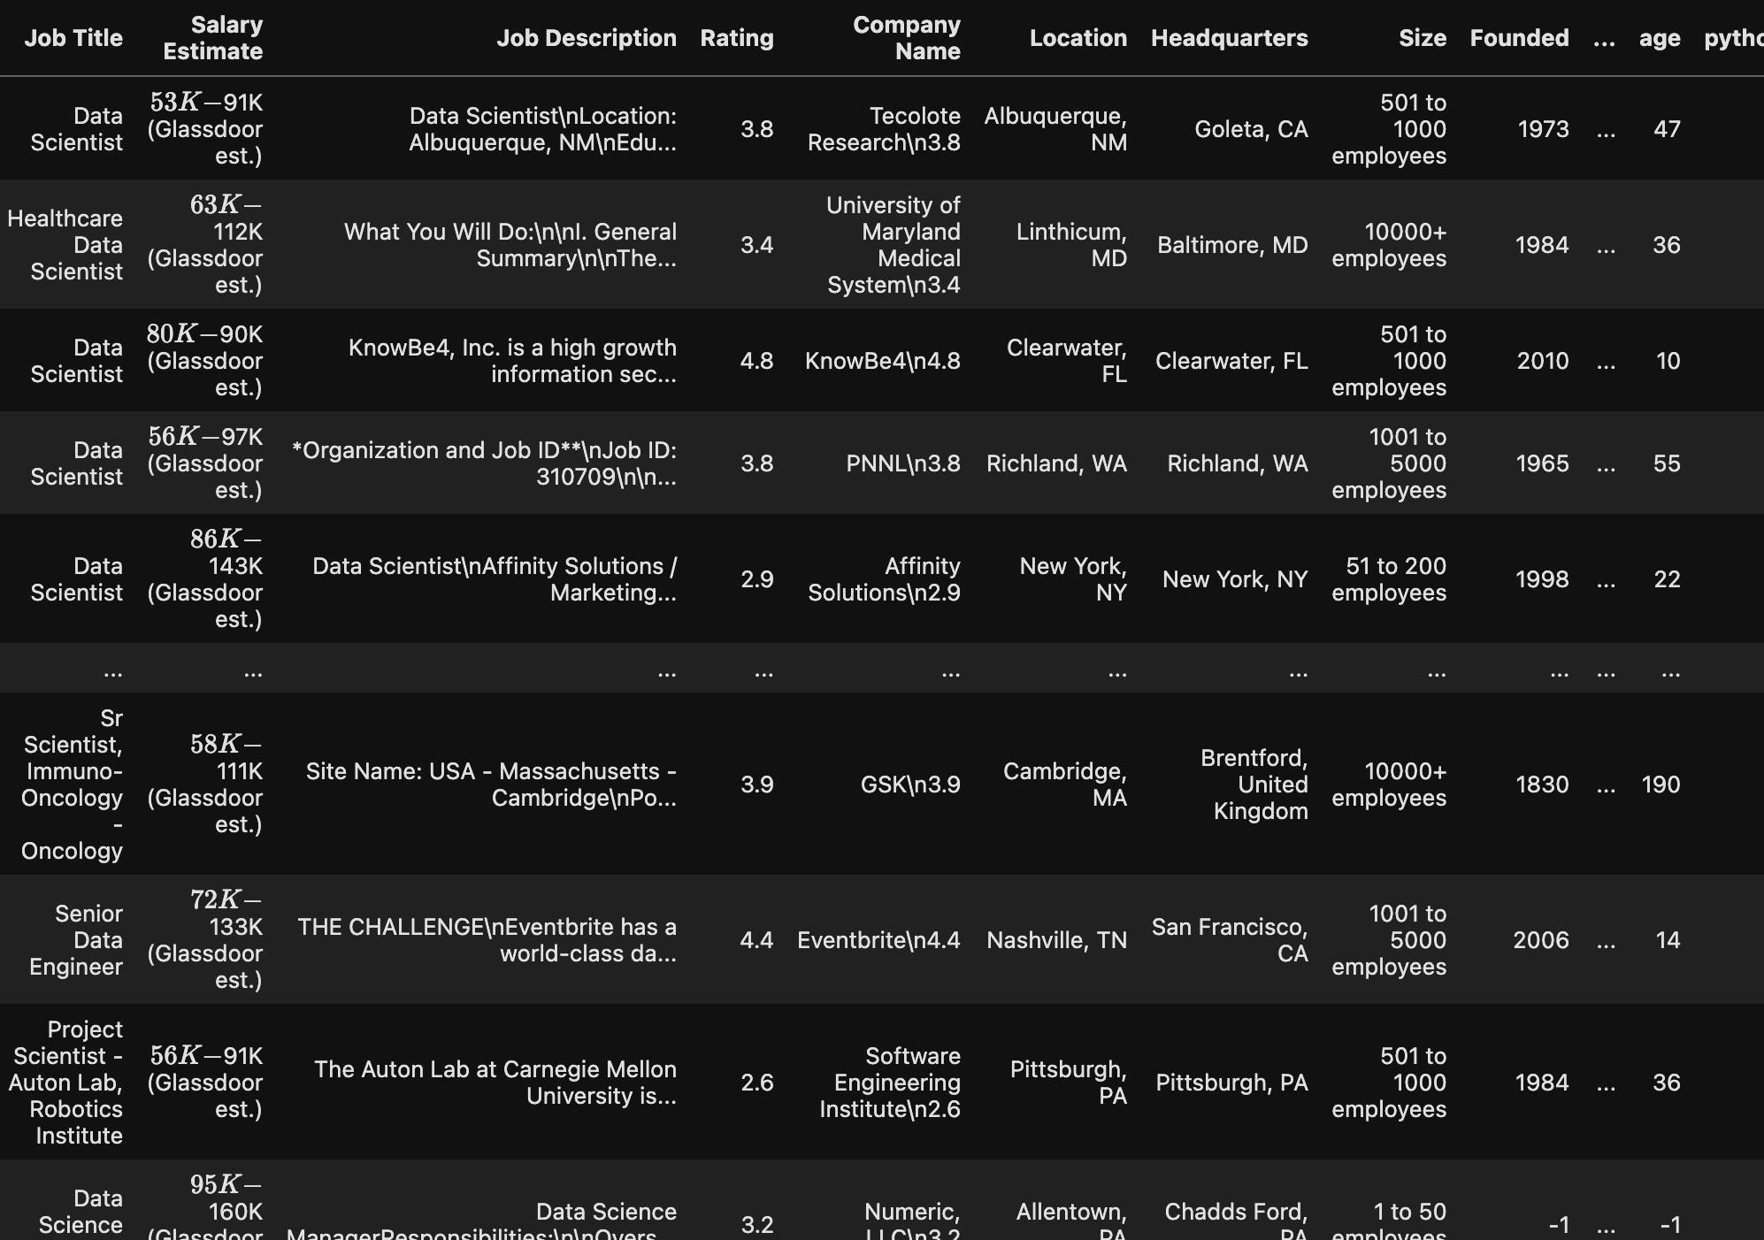
Dataset Overview
Dataset Size: Approximately 10,000 entries
Columns:
Job Title
Location
Company Type
Skills (e.g., Python, AWS, Excel)
Salary (Target Variable)
Other factors (e.g., company rating, experience, etc.)

Slide 9
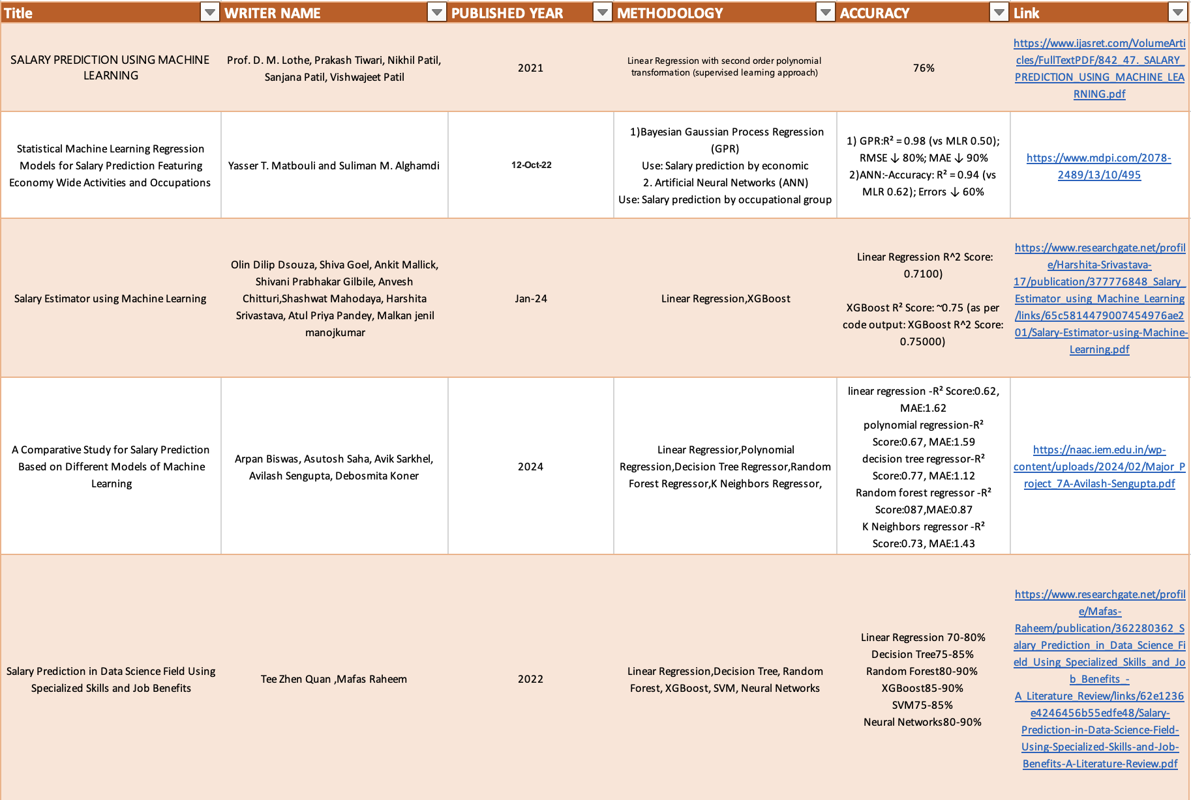

Slide 10
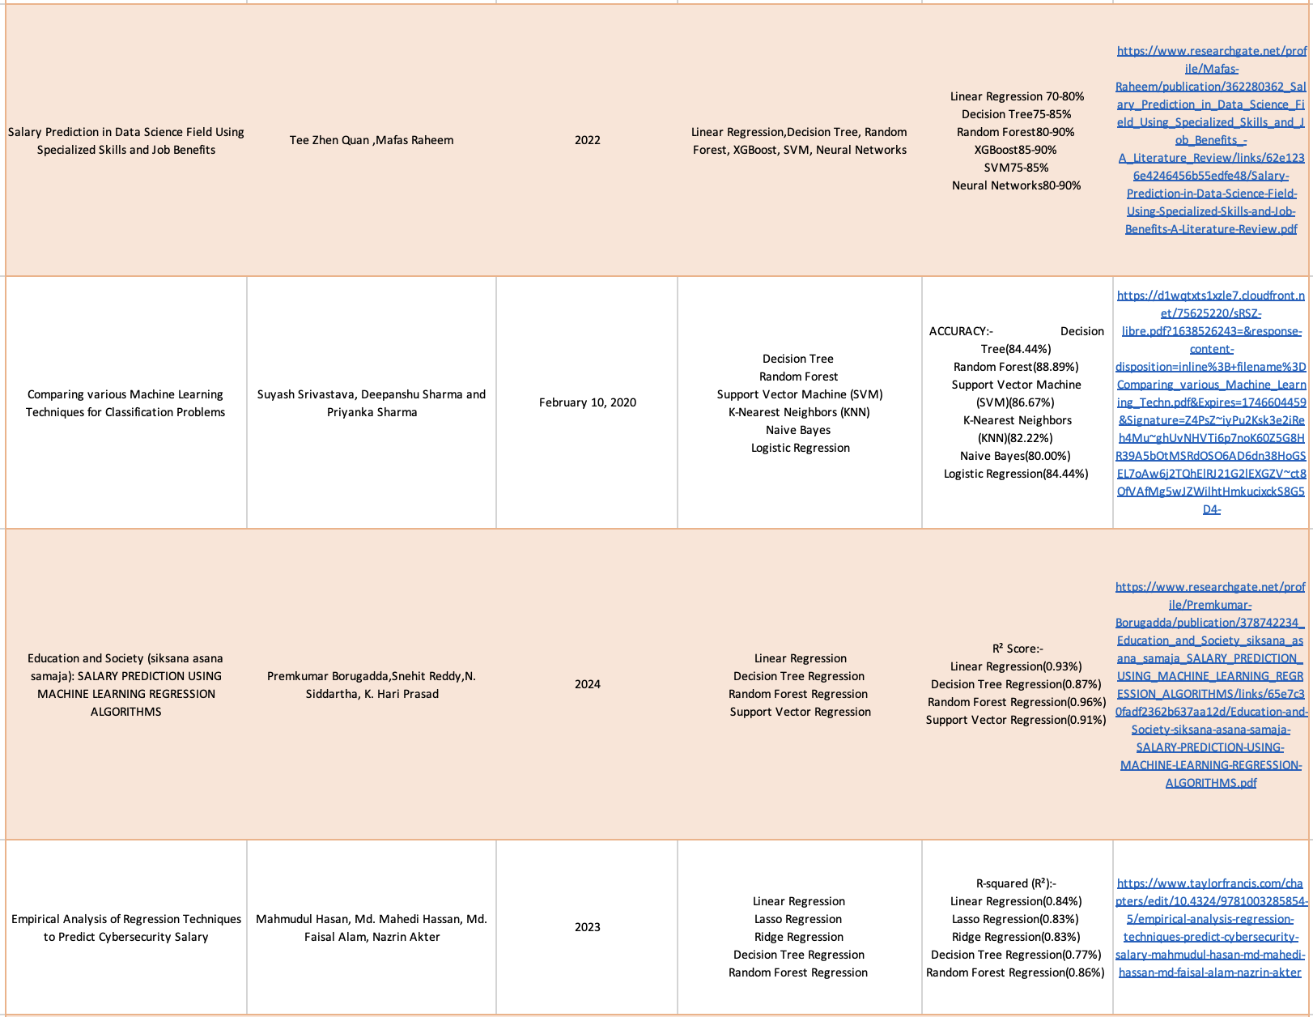

Slide 11
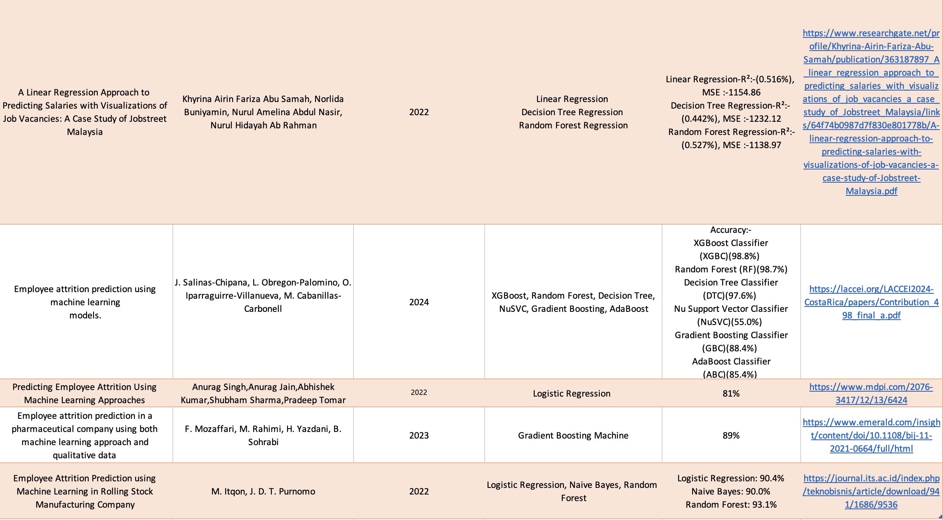

Slide 12
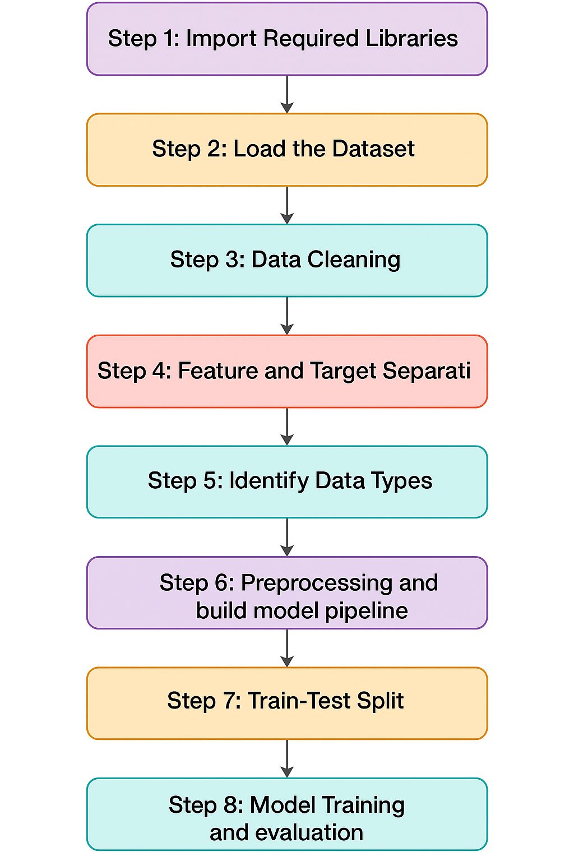
Research Methodology

Slide 13
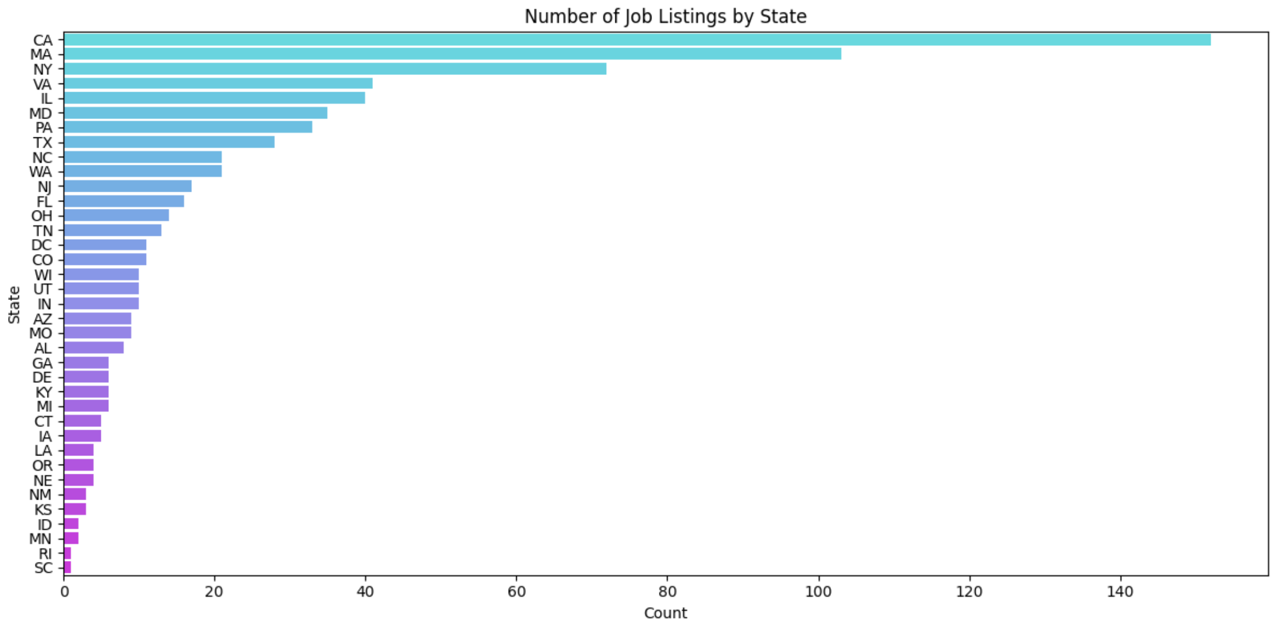
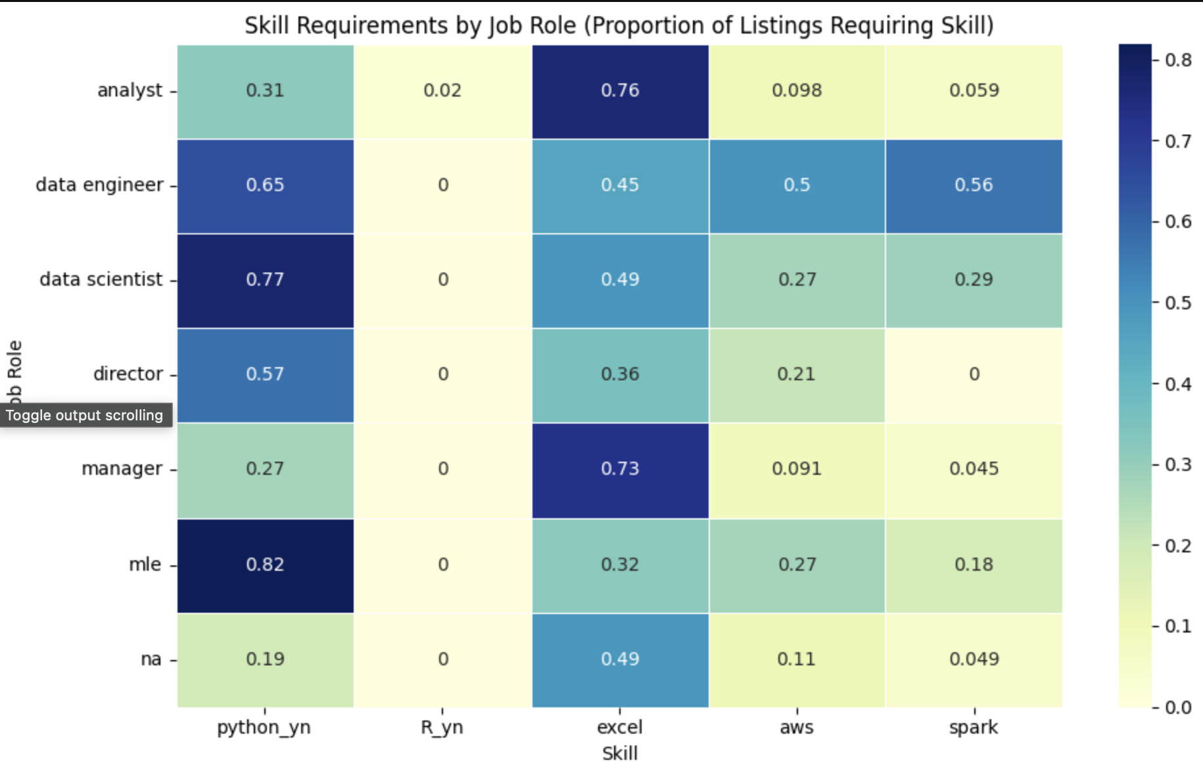
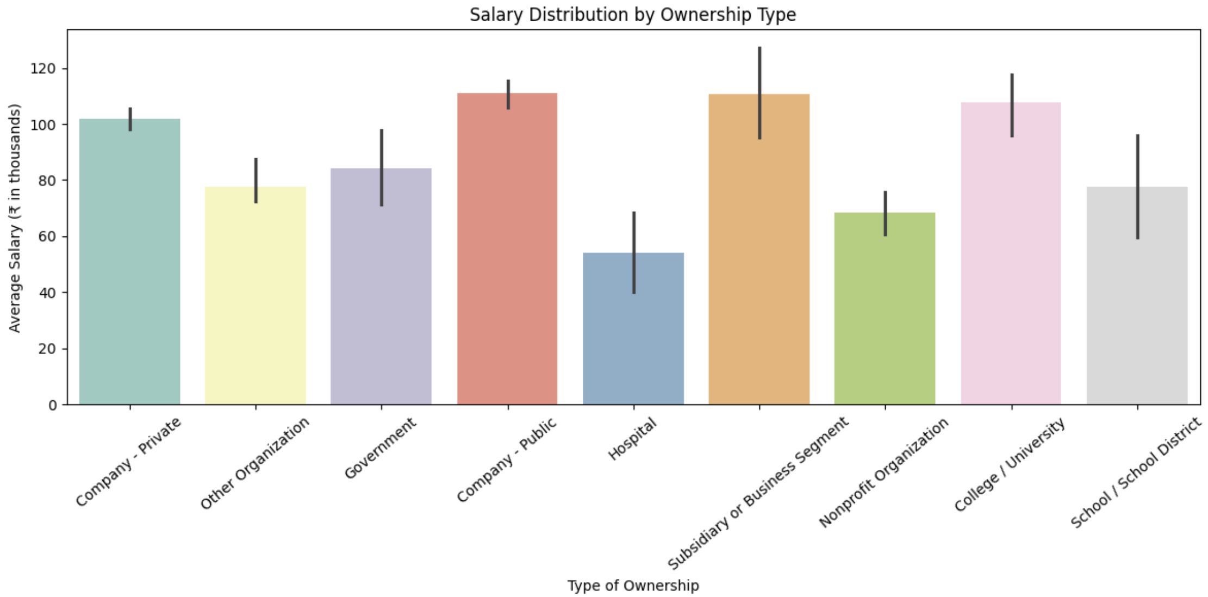
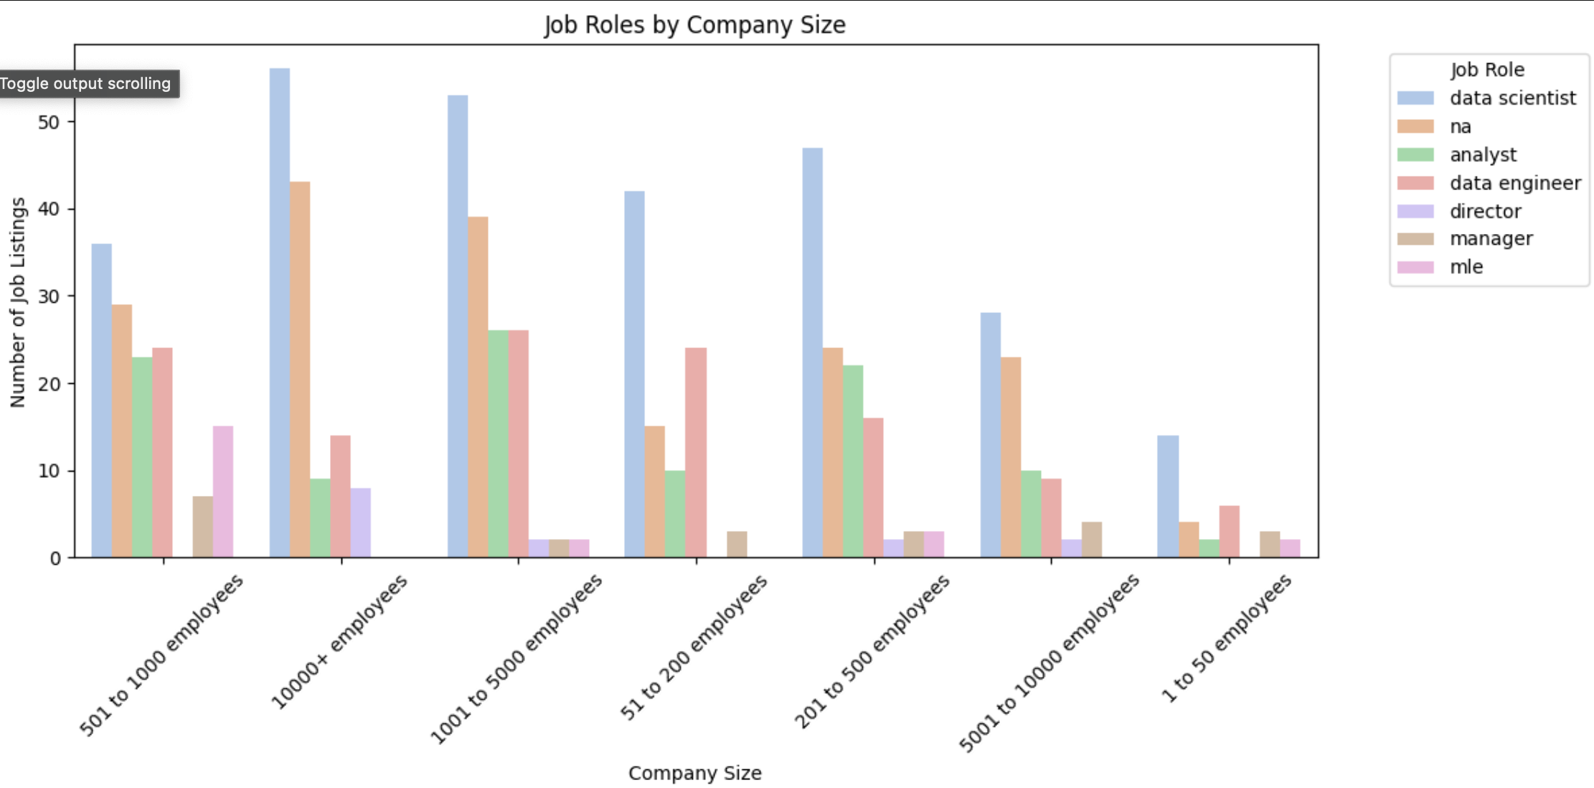
Data Insights

Slide 14
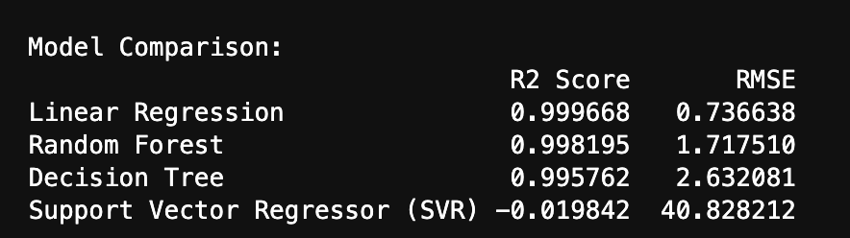
ML Models and Model Comparison Results
Best performance based on R² score: 99.96% (Linear Regression model)
Very low Root Mean Squared Error (RMSE): 0.73 — indicating very high accuracy
Works well for multivariate continuous prediction — salary prediction based on multiple features like job title, skills, location, etc.
Easy to interpret and deploy — Linear Regression is simple, explainable, and requires less computational power.
Lightweight model: Fast to train and predict in real-time, making it suitable for web application deployment.

Slide 15
How the Application Works:
User enters job details via a simple form (e.g., job title, location, skills).
The backend processes the data and uses the machine learning model to predict the salary.
Users can view the predicted salary and visualize trends via the dashboard.

Slide 16


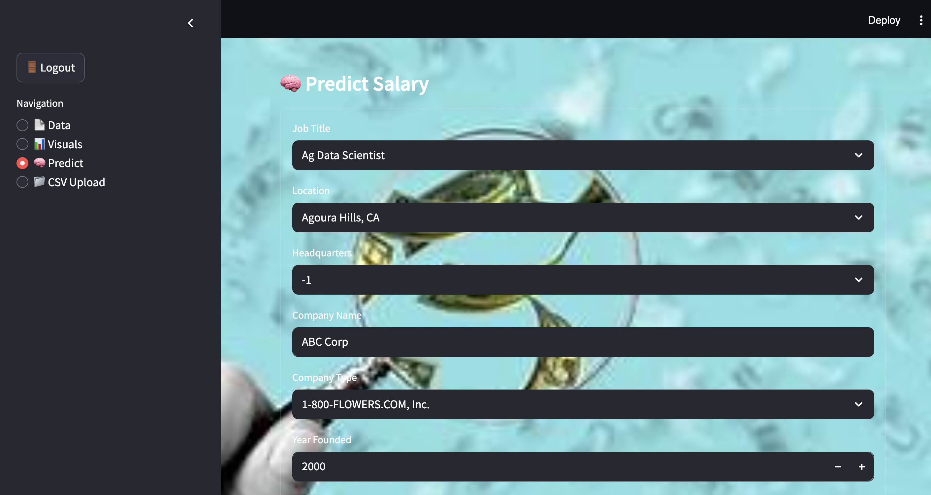
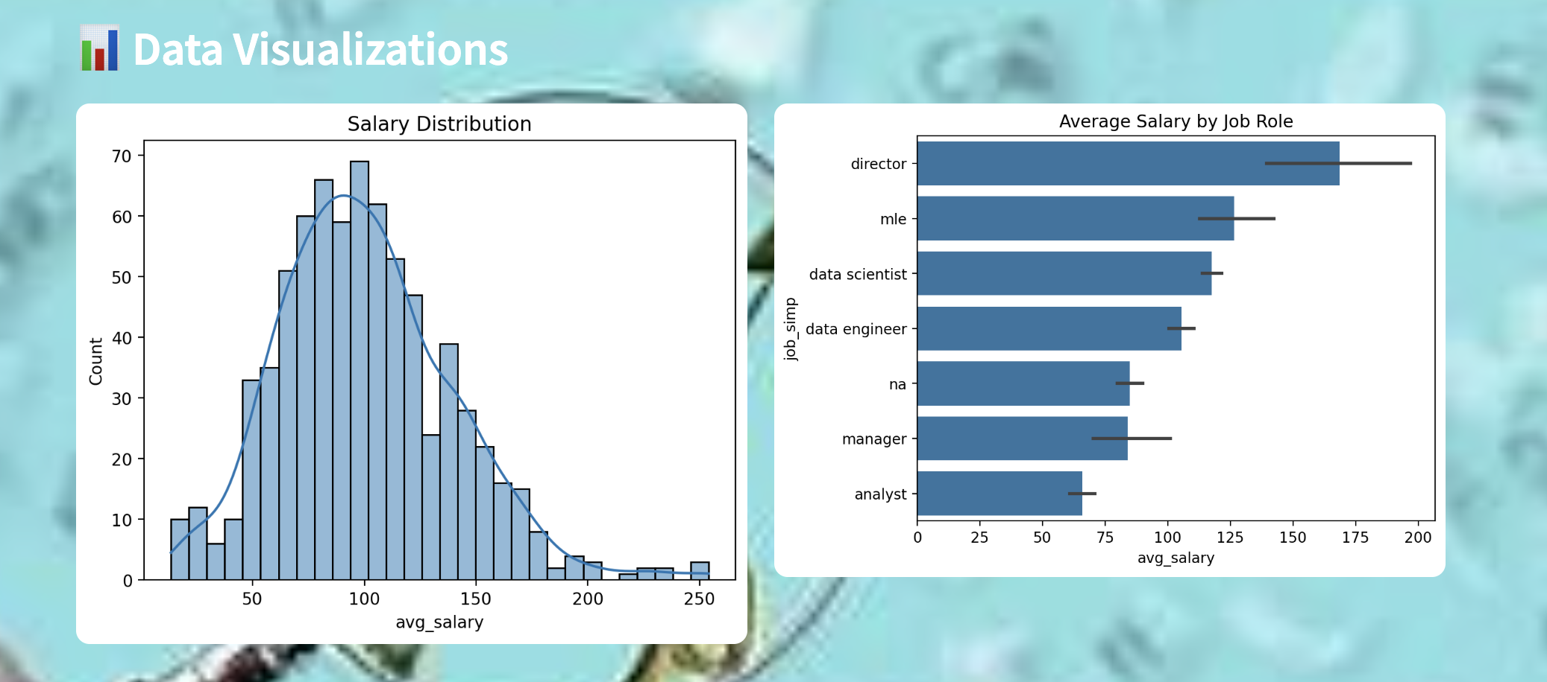
User Interface Image

Slide 17
Next Steps
Migrate to a SQL database for scalability.
Enhance the frontend UI for better user experience.
Implement secure login for admin access.
Deploy the app online for public access.
Add more features for advanced predictions.

Slide 18
Conclusion
Summary: The salary prediction app helps job seekers and employers make informed decisions by providing data-driven salary estimates for tech jobs.
Scalable and User-Friendly: Easy to use, can be scaled with more data and features, and provides actionable insights.

Slide 19
THANK YOU
Suparna Nadendla
24WU0202345
Done by:

